Slide 1
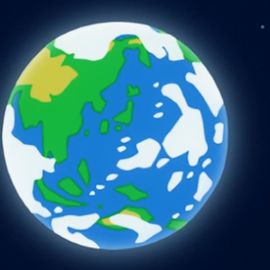
Festival Under Globalization
Speaker : ma xin
machine
Group 6

Slide 2
Contents
1.Traditional Festival
2.International Festival
3.Cultural Festival

Slide 3
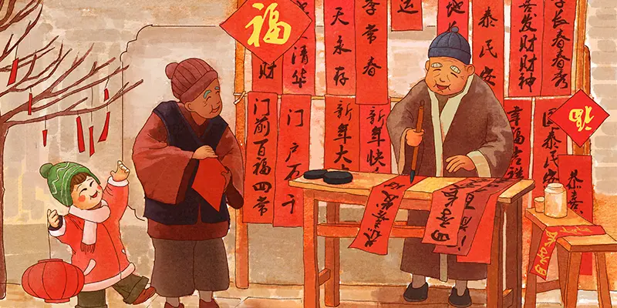
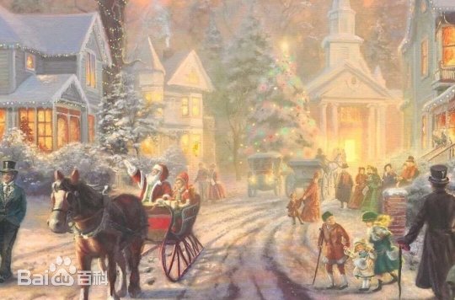
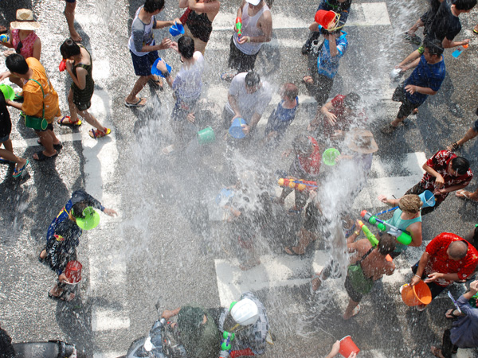
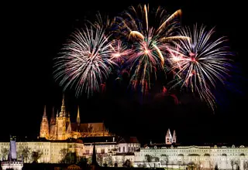
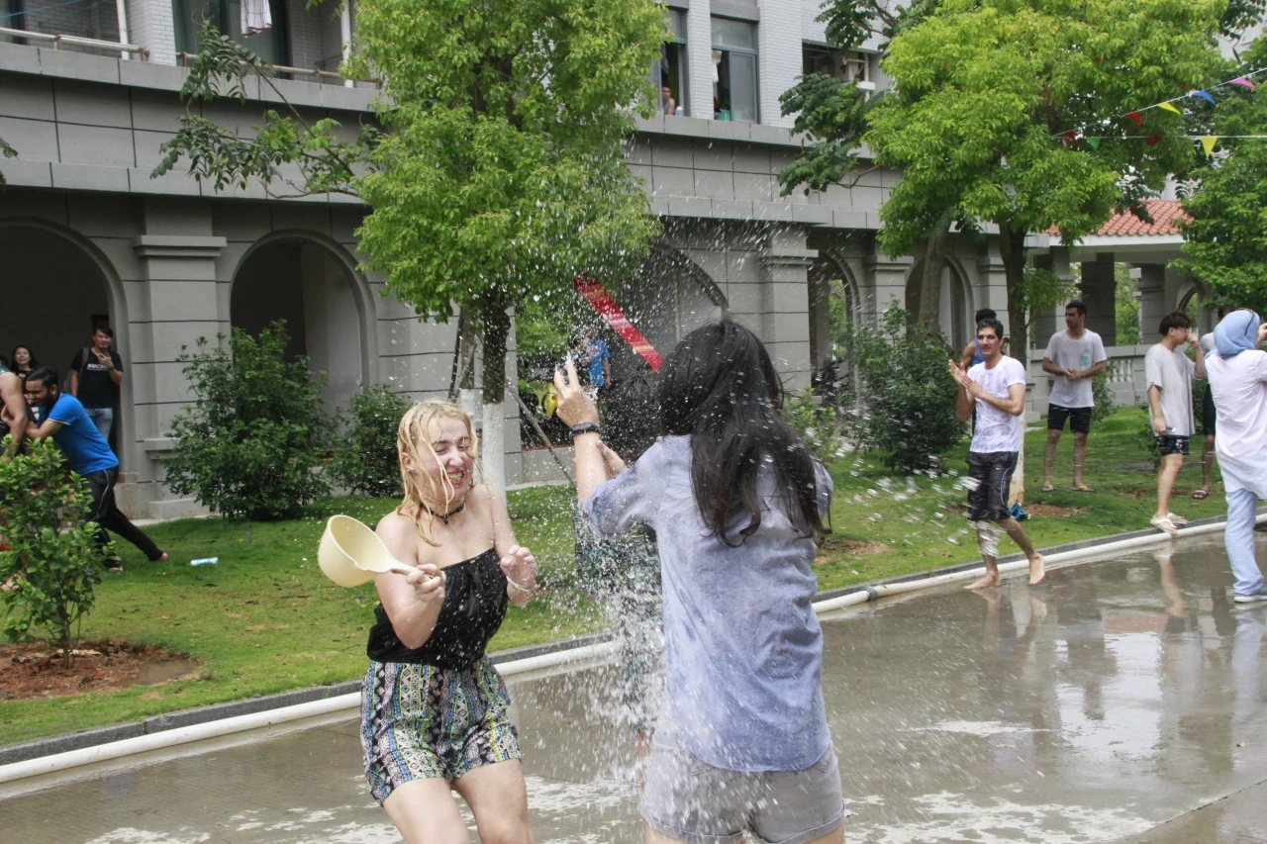
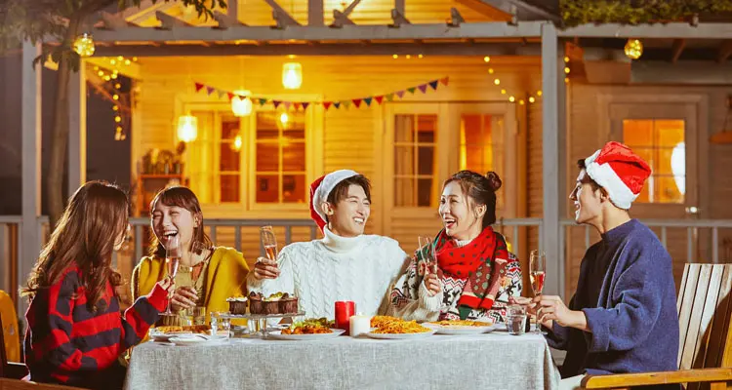
Traditional Festival
Chinese New Year
Christmas
Songkran
local religions and cultures
In China
In The West
In Thailand
cultures and customs
spread to all parts of world
In London
In China
At XMU

Slide 4

International Festival
International Workers’ Day May Day/Labor Day/May Day
International Working Women’s Day
World Consumer Rights Day
Mother’s Day
Father’s Day
…

Slide 5


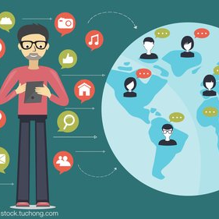
International Festival
The World Earth Day
World Environment Day
…
World Sleep Day
…
World Law Day
…

Slide 6



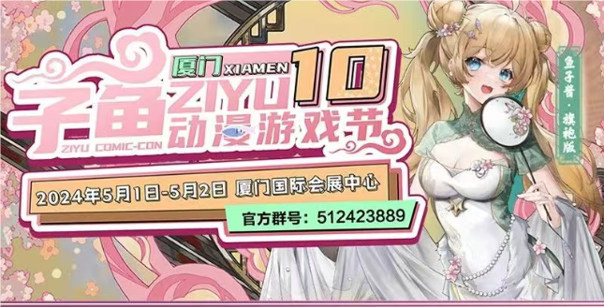
Cultural Festival

Slide 7
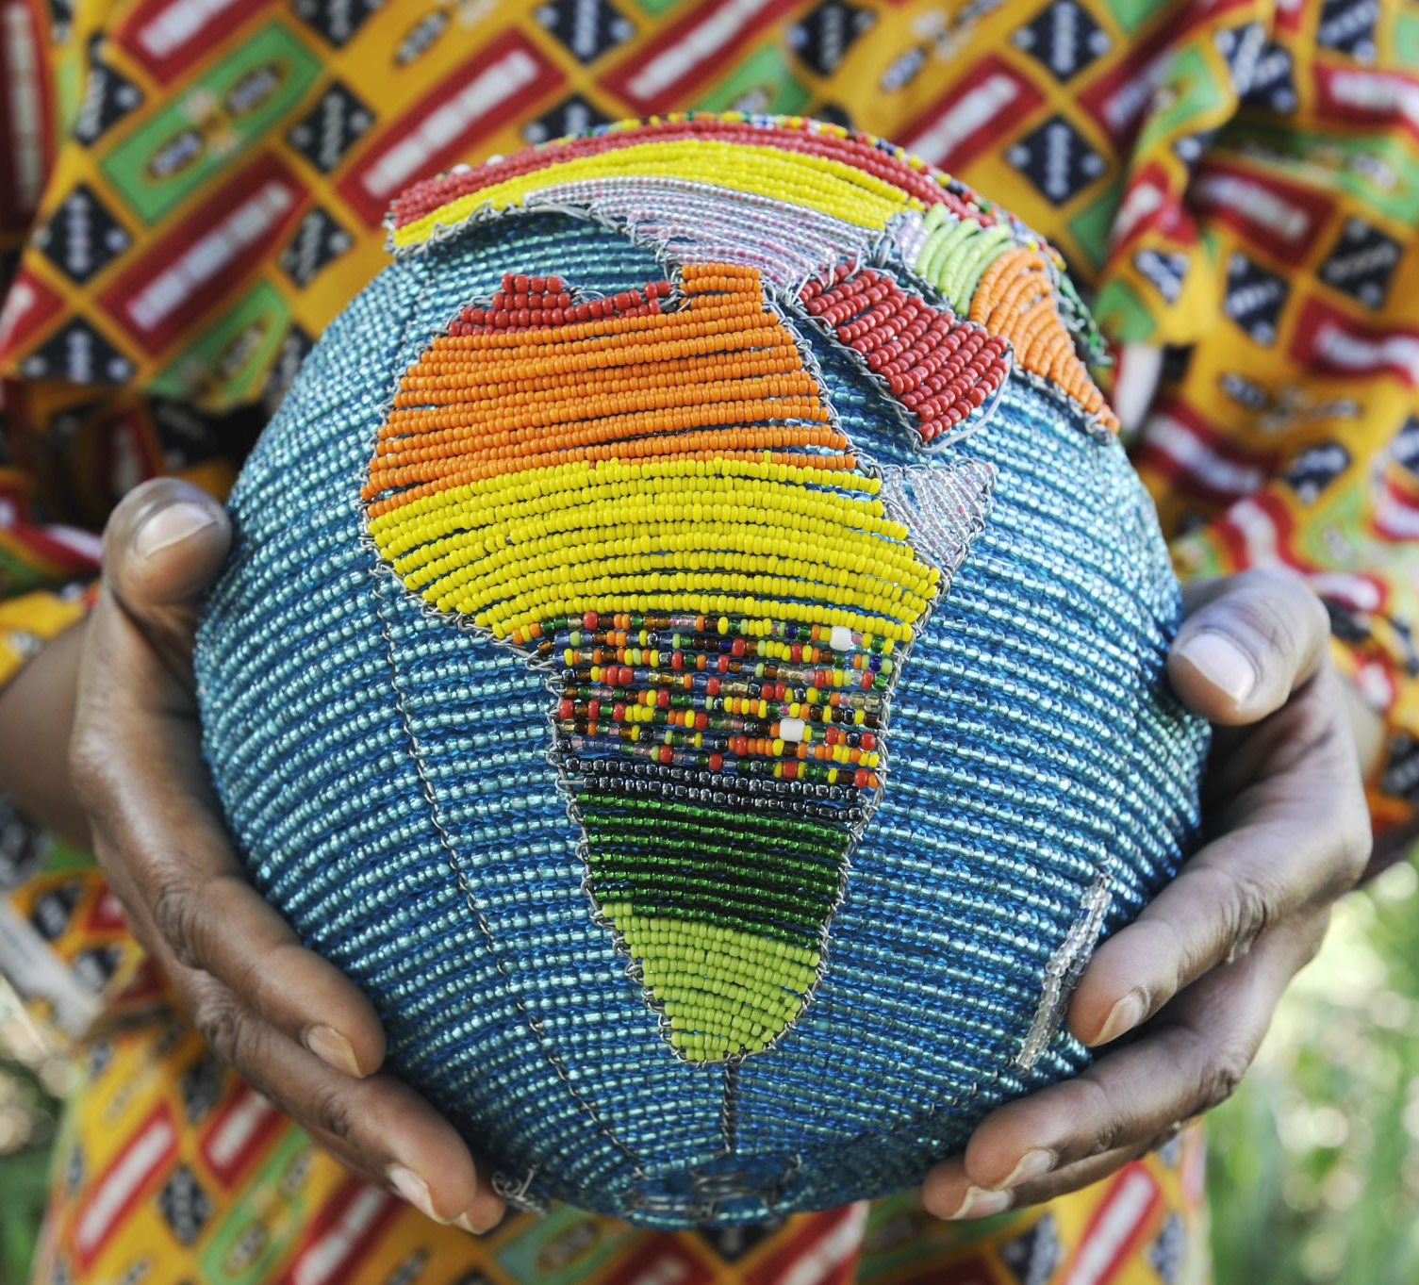
Conclusion
In conclusion, under globalization, some existing festivals spread to other regions and some festivals are established. Now, all these festivals implicate all aspects of globalization.

Slide 8
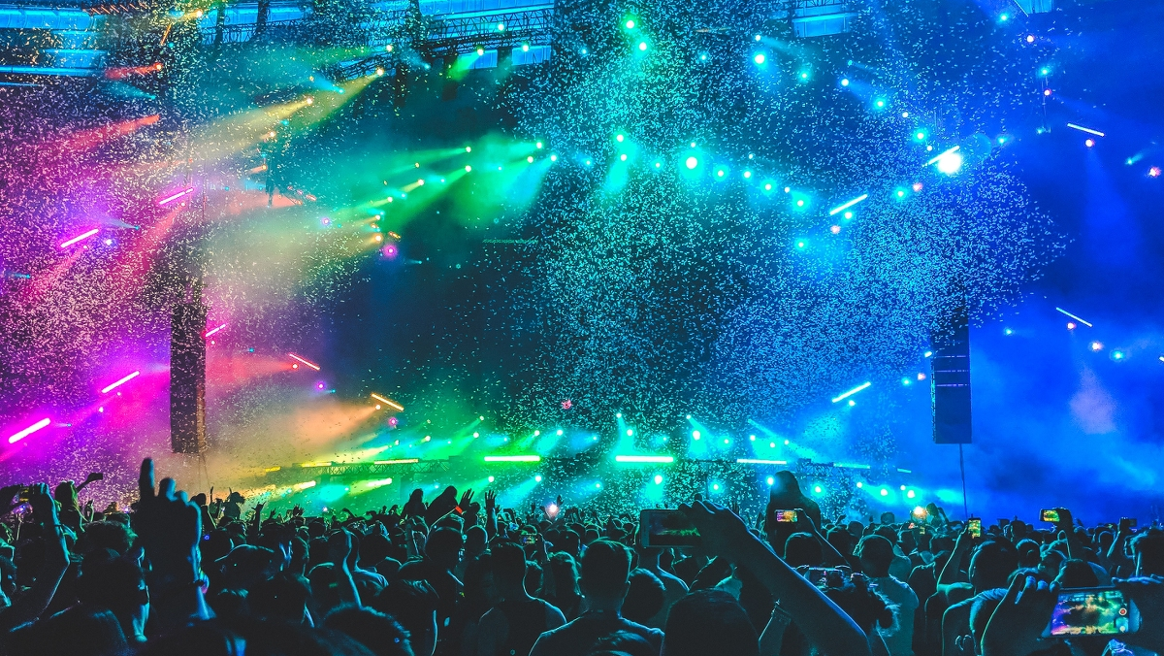
Thanks for listen!

